Slide 1
Autism Spectrum Disorder in Alabama
July 11, 2019

Slide 2
Did you know…
Autism affects 1 in 59 children and 1 in 42 boys
Autism prevalence figures are growing
Autism is one of the fastest-growing developmental disorders in the U.S.
Autism costs a family $60,000 a year on average
Boys are nearly 5 times more likely than girls to have autism
There is no medical detection or cure for autism
Autism does not discriminate against races, ethnic groups, and socioeconomic status
https://www.autismspeaks.org/what-autism/facts-about-autism
Notes:
Who has met or knows someone with a diagnosis of Autism Spectrum Disorder?

Slide 3
The Numbers
Year | Prevalence Rate
1980s | 1 in 10,000
1990s | 1 in 2500 1 in 1000 1 in 500
2000 | 1 in 250
2002 | 1 in 150
2004 | 1 in 125
2006 | 1 in 110
2008 | 1 in 88
2010 | 1 in 68
2012 | 1 in 69
2014 | 1 in 59

Slide 4
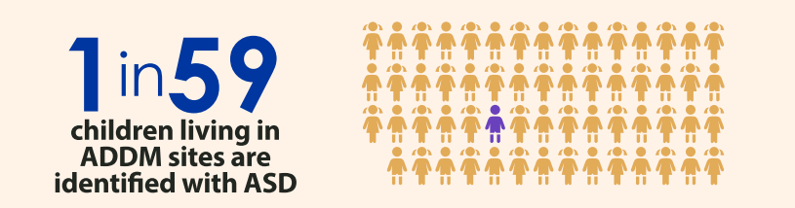
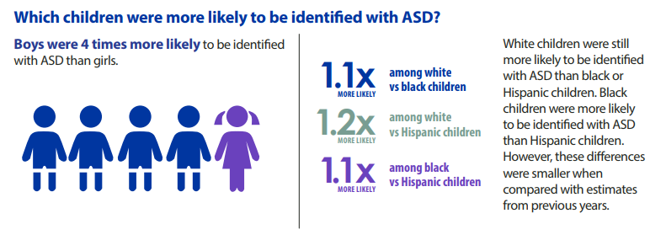
ADDM data
Notes:
About 1.7% of 8yos
Though boys were 4 times more likely to be identified with ASD than girls, ASD diagnoses in females are on the rise. It’s been said and researched that many females with ASD have a “social camouflage.” Generally, girls are able to socially adapt easier than boys, and the same is true for girls on the spectrum. We often see girls that are seemingly engaged (maybe standing with a group of people and trying to do what they do because she knows that’s what she is supposed to do), but these girls are often not connecting, which is the big difference. It’s easier for girls to fall under the radar until the teenage years when social atmospheres become much more complex. At that point, their social deficits start to unfold and the question of ASD arises. Thus, many girls are not diagnosed until later in life. Of course, there are always exceptions to this, but this is generally what we see in clinical settings. Researchers are starting to explore this idea of “social camouflage” more.

Slide 5
What is Autism Spectrum Disorder (ASD)?
Diagnostic Criteria (DSM 5):
Deficits in social communication and social interaction
  Reciprocity
  Nonverbal communicative behaviors
  Relationships
Restricted, repetitive behaviors
  Motor movements
  Routines
  Fixated interests
  Sensory
Notes:
ASD Definition
Restricted and repetitive behaviors
Social communication
Difference in presentation of symptoms

Slide 6
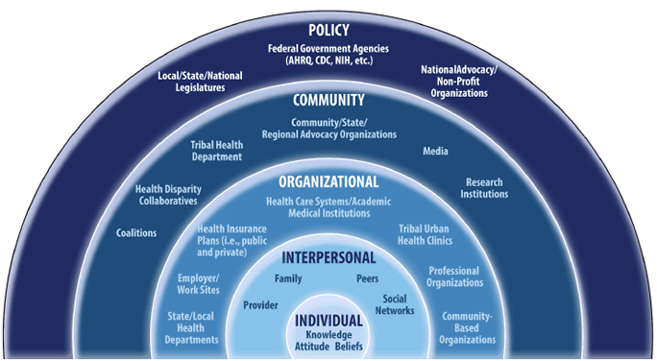
Social-Ecological Model
Notes:
When we think about services for any individual, but specific to this discussion the autism population, we have to consider all determinants of health and how they impact an individual. The Social-ecological model is often used both in social work and public health to illustrate the role each family, provider, agency, community, or government can play a role in an individuals health care.

Slide 7

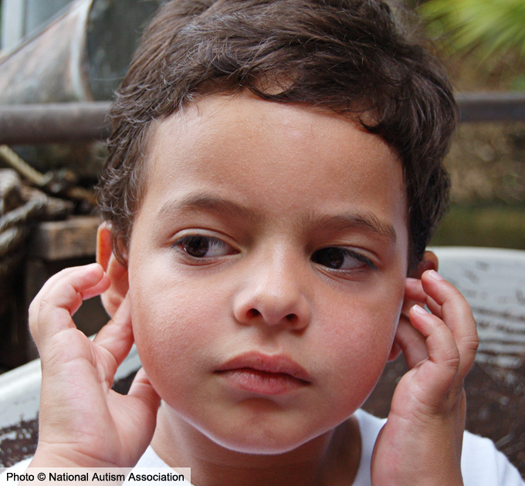
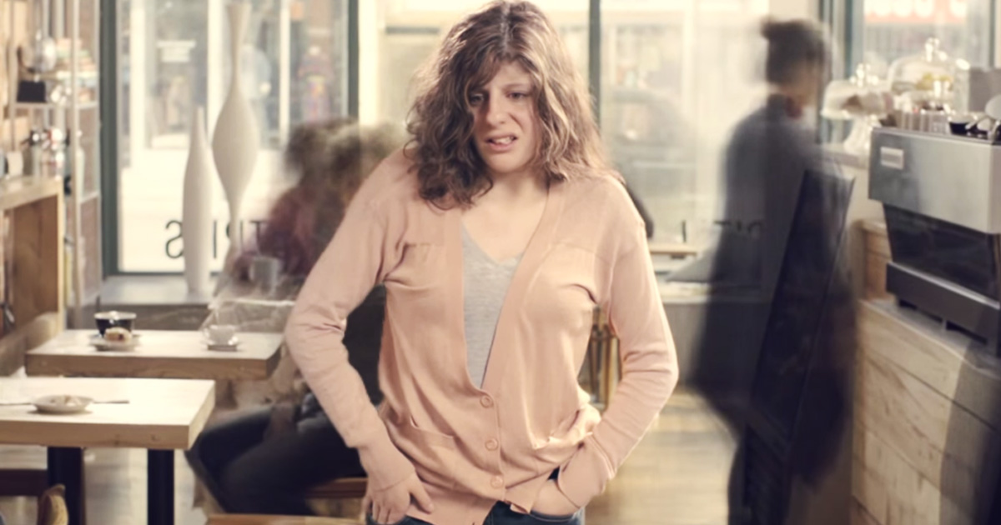
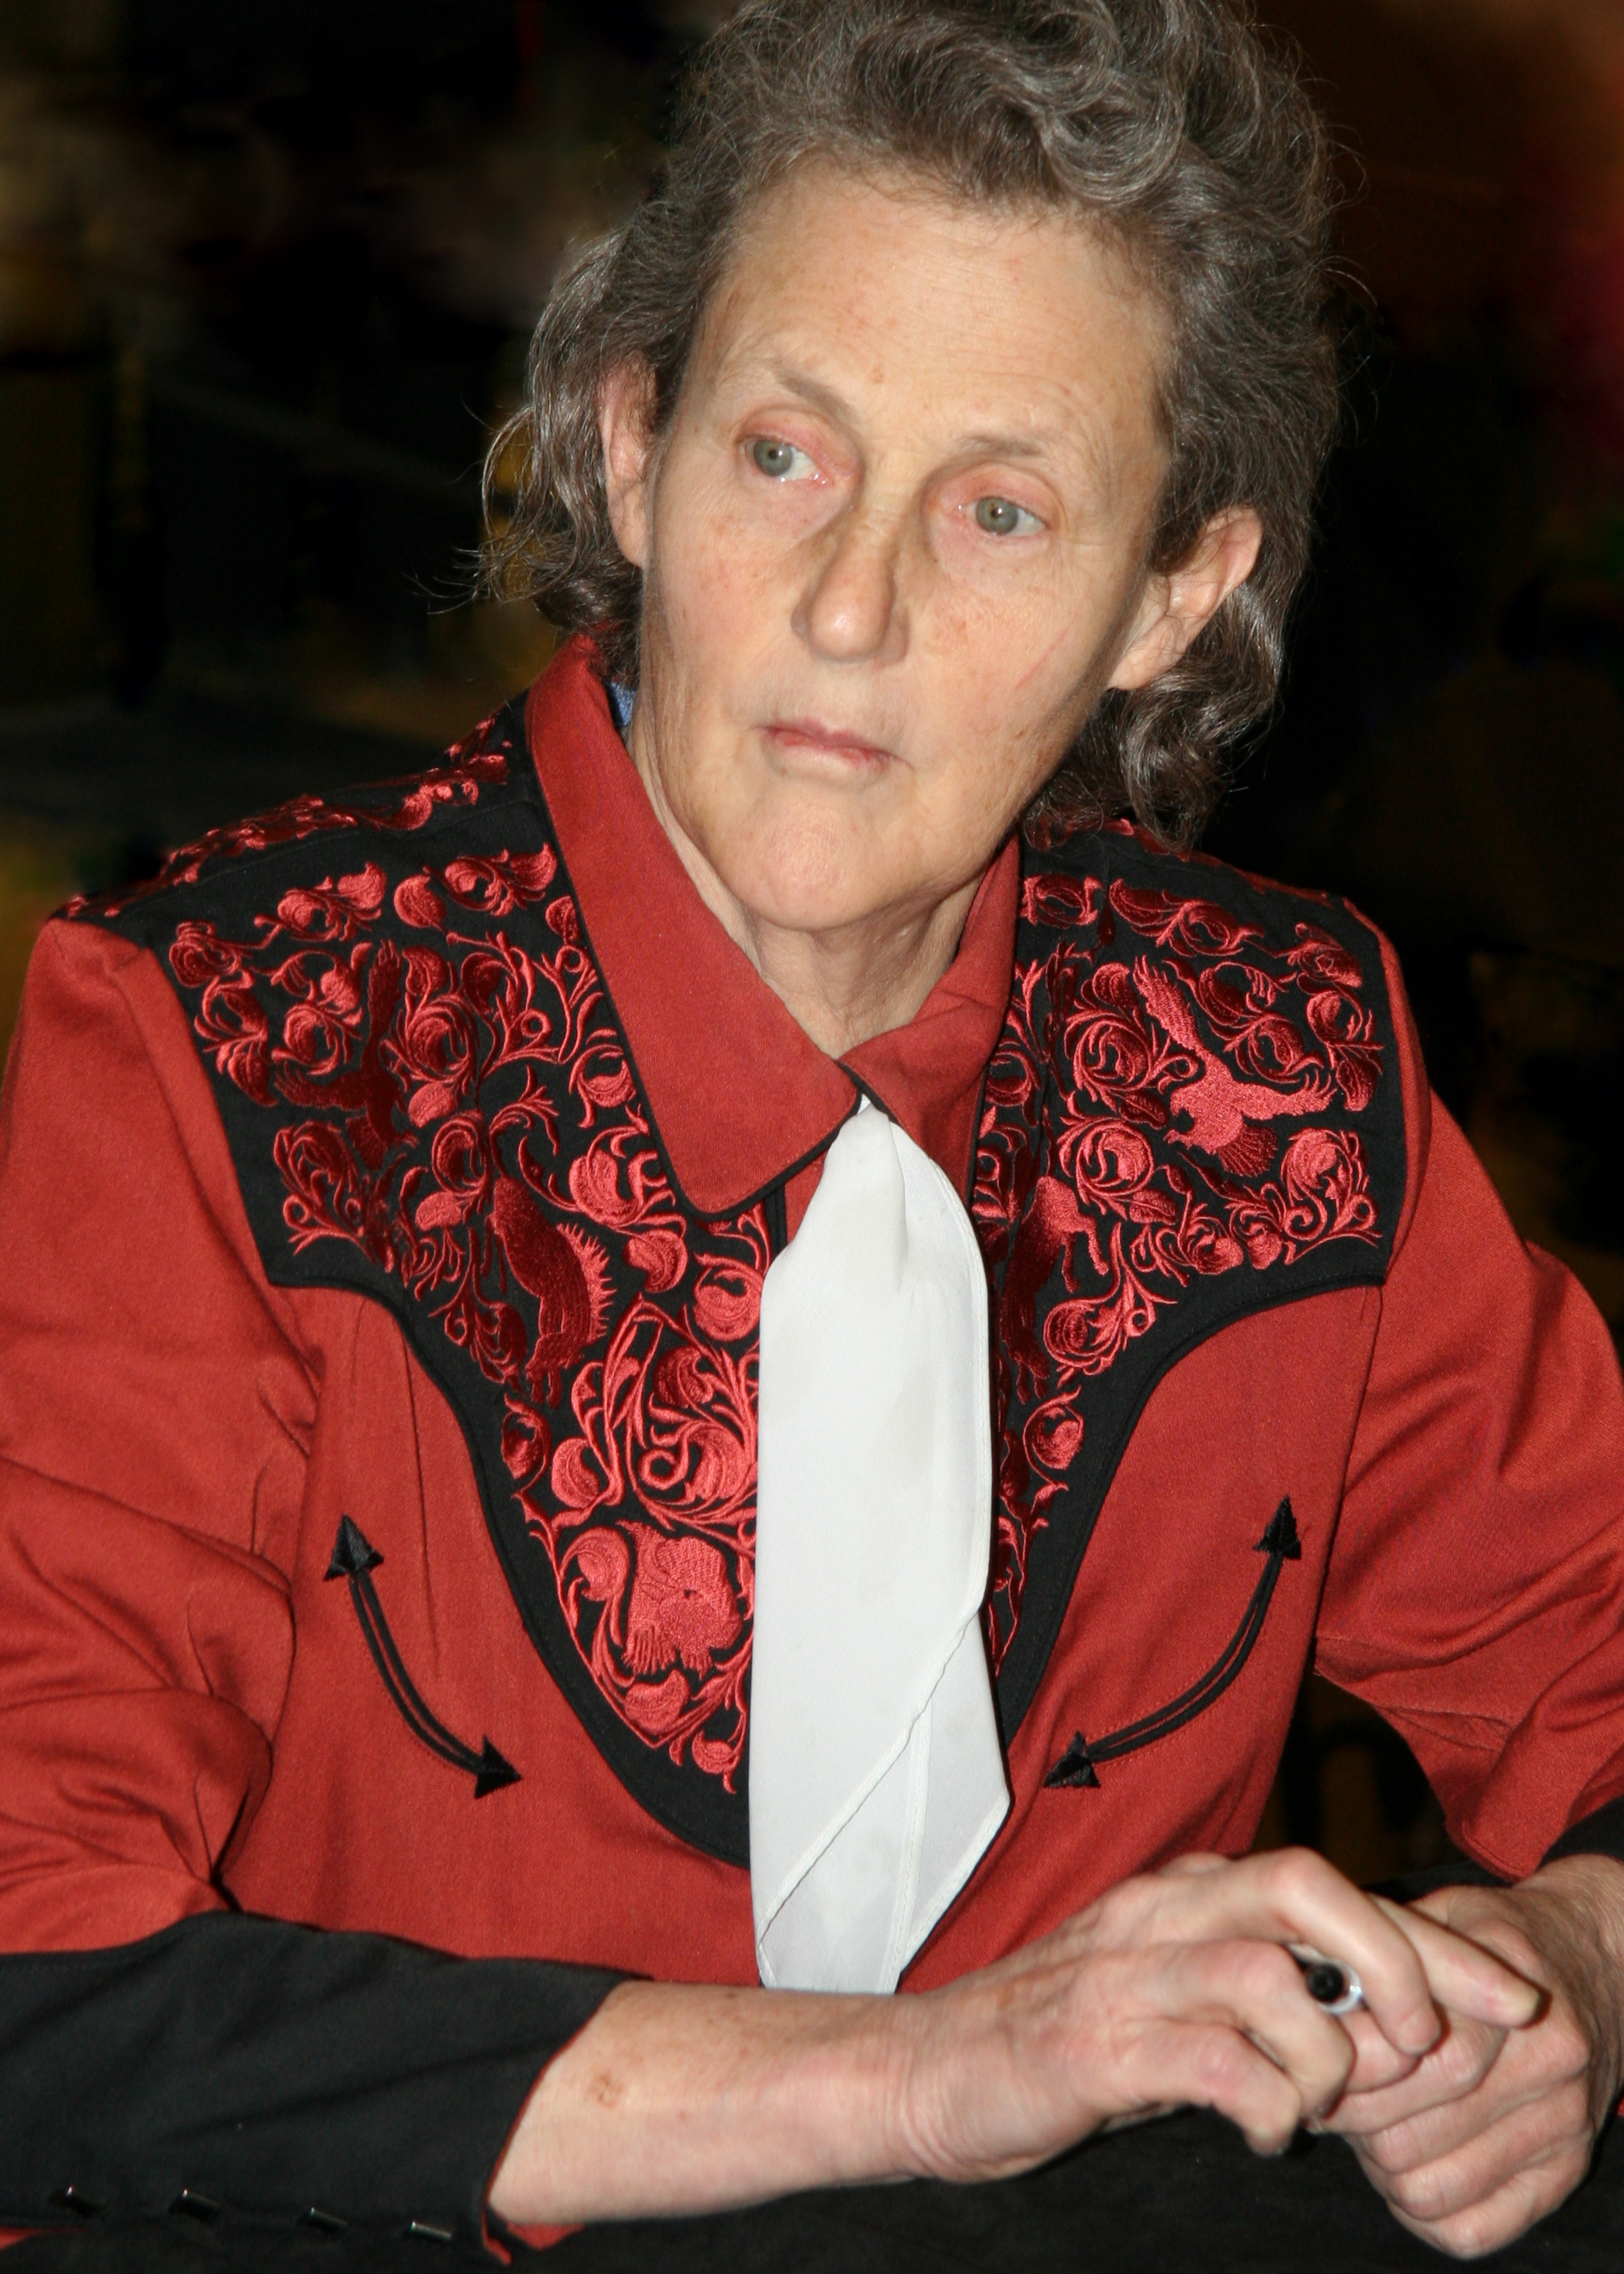

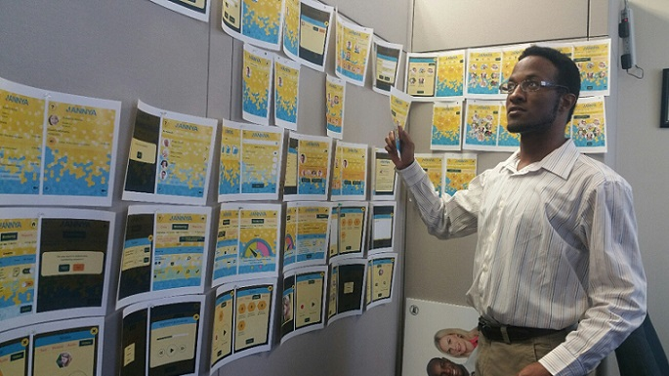
Life Course Perspective
Notes:
Lifespan (long term outcomes in mind) – comprehensive approach to care (how services are protective factors for longterm outcomes)
EI (0-2)
CRS (0-21)
VR (14+)
SAIL

Slide 8

Early Childhood & Transition to School
Parent support and education
Screening & Developmental Monitoring
Early
Intervention
Communicate with Families and Caregivers
Pre-school and kindergarten readiness
Socialization

Slide 9

School Age
Home based services and family support
School Services
Private or Outpatient Services
Transition Planning
Peer Interaction
Health and Medical Needs

Slide 10

Transitioning to adulthood
Planning for the Future:
Post-secondary Education
Job Training
Financial and Legal Services
Housing
Health Care
Socialization
Community Engagement

Slide 11
Considerations for Transition: Areas in Which Individuals May Need Support
Personal care
Cleaning and laundry
Grocery shopping
Nutrition and cooking skills
Transportation
Housing/living arrangements
Money management/ Budgeting
Medication management
Socialization
Relationships / Social cues
Community Membership
Hobbies and recreation
Addressing health needs
Advocacy
Oversight/coordination/long term planning
Guardianship
“Accessibility in Alabama” – by Brooke Bowles and Joe Carter (Glenwood Autism & Behavioral Health Center)

Slide 12

Adulthood
Education / Job Training and Support
Housing and Related Services
Socialization and community engagement
Health and Medical Needs
Community support and advocacy
Long-term
Financial & Legal
Support and Planning

Slide 13

Available Resources
First Responder Trainings
Annual Camps for families
Annual Autism Day at baseball field (Barons, Biscuits, Bay Bears)
Sensory Movies
Legislative Day
Library Program
Conferences

Slide 14
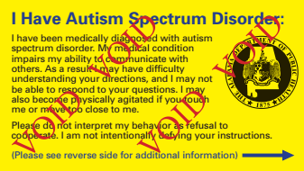
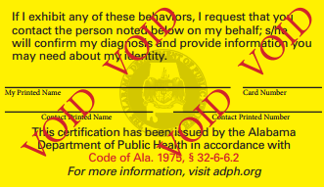
Autism ID Card
Available through AL Dept Public Health.
Complete an ASD Card Registration Form (available on ASA’s website) and bring to any county health department along with a government issued identification card or document and $10 to receive a card.
Form must be signed by healthcare provider.
Social story available on ASA webpage.

Slide 15
Autism Friendly Campaign
Regions, ASO, Red Mtn. Theatre Co., Birmingham, Museum of Art…
Educating local businesses and organizations about autism
Providing a mechanism for businesses/organizations to promote their awareness and autism friendly programs to families with autism
Informing local businesses/organizations about the benefits of becoming “autism friendly”

Slide 16

al.enablesavings.com
Allows individuals with disabilities to open tax-exempt savings accounts to save for disability-related expenses without impacting eligibility for resource-based benefits.
Annual contribution limit $15,000
Account limit $400,000

Slide 17
Networking Groups
Areas Represented:
Alexander City
Auburn
Birmingham
Blount County
Calhoun County
Centerpoint
Chilton County
Clarke/Washington Counties
Cullman County
Decatur/Hartselle
DeKalb County
Demopolis
Dothan
Florence
Gadsden/Etowah County
Gulf Shores
Hamilton
Huntsville
Limestone County
Lineville
Mobile
Montgomery/Tri-County
Selma/Dallas County
St. Clair County
Sumter County
Troy
Tuscaloosa
Walker County
Winfield

Slide 18
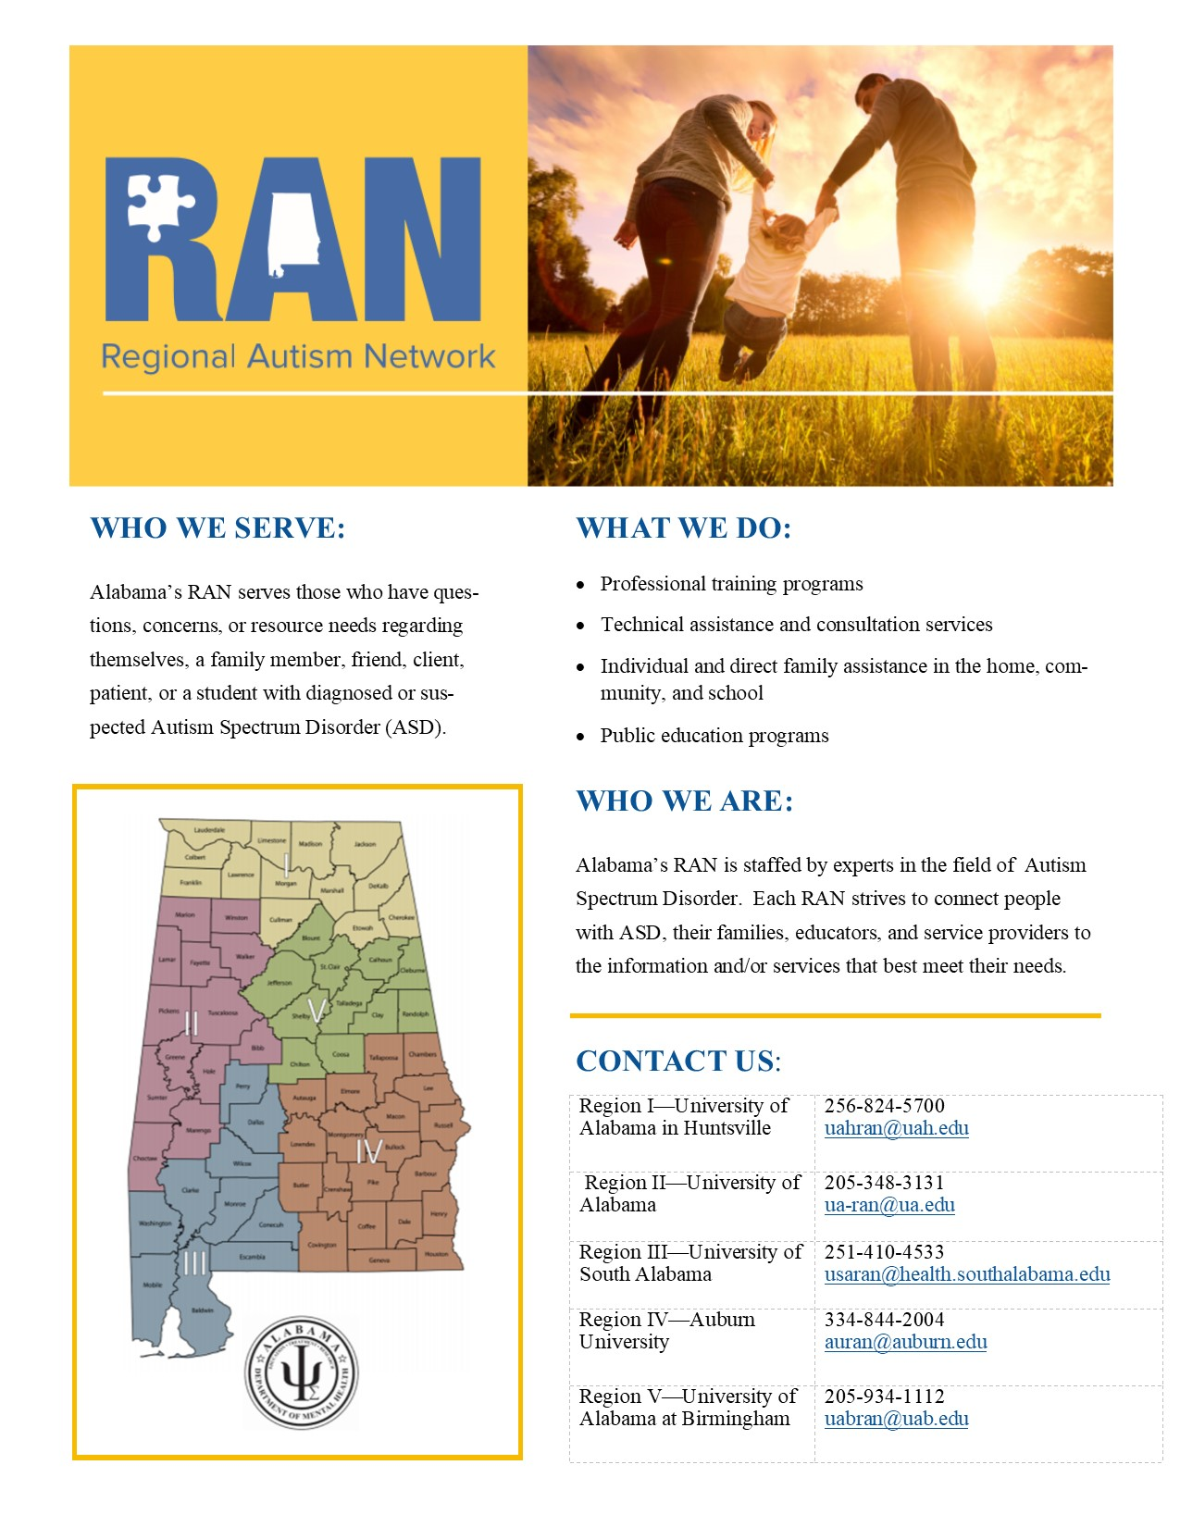

Slide 19
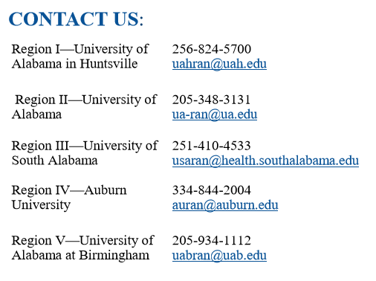
University ran numbers

Slide 20
Regional Autism Networks
A staff that has expertise in autism and related disabilities.
Individual and Family Assistance
Technical assistance and consultation
Professional training
Public education
(Act 2009-592)

Slide 21

Accessing Publicly Funded Services for Adults in Alabama
Alabama Department of Rehabilitation Services
Alabama Department of Mental Health
Your Personal Funds
“Accessibility in Alabama” – by Brooke Bowles and Joe Carter (Glenwood Autism & Behavioral Health Center)

Slide 22
Your Funds
Alabama Family Trust
We are a non-profit, 501 (c) (3) special needs trust serving children and adults with disabilities. Our organization was created in 1994 by an act of the Alabama Legislature to encourage, enhance and foster the provisions of medical, social or other supplemental services for persons with a mental or physical impairment. alabamafamilytrust.com
Special Needs Trust
A special needs trust is a trust designed for beneficiaries who have a disability. It is written so the beneficiary can enjoy the use of property that is held in the trust for his or her benefit, while at the same time allowing the beneficiary to receive essential needs-based government benefits. Special needs trusts are sometimes known as supplemental needs trusts in the United States.
“Accessibility in Alabama” – by Brooke Bowles (Triumph Services) and Joe Carter (Glenwood Autism & Behavioral Health Center)

Slide 23

Autism Council’s Charge
The Alabama Interagency Autism Coordinating Council was created to meet the urgent and substantial need to develop and implement a statewide comprehensive, coordinated, multidisciplinary, interagency system of care for individuals with ASD and their families.
Notes:
Because there were so many issues, the Autism Task Force was created in 2007. In 2008, the Autism Needs Assessment was completed. In 2009, the AIACC was approved as the permanent entity to carry on the work of the Autism Task Force.

Slide 24
Autism Council’s Mission Statement
The Alabama Interagency Autism Coordinating Council guides a collaborative effort to facilitate a lifelong system of care and support for persons with Autism Spectrum Disorder or associated conditions and their families, so that they may enjoy a meaningful and successful life.

Slide 25
AIACC and Adults
Support education and training around long-term planning and support for individuals with ASD.
Engage in a coordinated state-wide systems development and decrease fragmentation of service systems.
Decrease wait-list time and increase availability/eligibility of services, such as diagnostics and mental health.
Increase the system in place to provide services based on limited insurance coverage and provider preferences.
Support adults with ASD in safely participating in their local communities, including seeking access to housing, employment, social, and mental health resources.

Slide 26
Gaps in Care and Emerging Services
  Adult services
  Comprehensive care
  Inclusion of medical providers
  Insurance barriers
  Medical providers familiar with ASD that accept Medicaid or Medicare
  Service providers that accept Medicaid and Medicare who are familiar with ASD
  Accessibility
  Health disparities among racial and SES groups
  Waitlists
  Waiver limited with extensive waitlist and IQ requirements (69 or below)
  Earlier transition services (age 14)
  More providers taking on ASD in their practices (state and private)

Slide 27



Contact Autism Society of Alabama
www.autism-alabama.org
1-877-4AUTISM
Jerry ASA / Autism Society of Alabama
@AutismSocietyAL

Slide 28
Contact Autism Council
Anna.McConnell@mh.alabama.gov
www.autism.alabama.gov
205-478-3402

Slide 30
University ran numbers

Slide 31
Questions?

